Slide 1
On a Spending Spree: The Real Effects of Heuristics in Managerial Budgets
Decaire & Sosyura
SSRN | 2022

Slide 2
How do managerial budgets decrease efficiency?
WSU
Research Question

Slide 3
Following Academic Theory
WSU
Setup
Benefits
Endow agents with control rights
Impose a clear budget constraint
Reduce monitoring costs associated with the day-to-day
Limitations
This hardly incorporates the complex dynamics of a firm’s investment opportunities
This should be the ultimate focus of capital allocation
Investment opportunities vary greatly over time, do not come in round amounts, and arise independently of the remaining budget balances and fiscal deadlines
The Modern Firm
Top Management
Midlevel Managers
Employees

Slide 4
Ad Spend
WSU
Data
A Granular Analysis of Managerial Spending Behavior
Daily transaction-level data on the allocation of nearly $400 billion across 3.4 million itemized expenditures by 347 publicly traded firms (2010-1019)
Weekly reports cover 100 billion transactions for 4.5 million products, accounting for the majority of physical sales in grocery stores and drug stores (53% and 55%, respectively)
Economic Significance of Ad Spend
Ad Spend of the mean firm are comparable to annual expenditure capital investment (84% of CapEx)
This exceeds the spending on R&D (155%)
Ad spend remains a key driver of a firm’s competitive advantage

Slide 5
Heuristic Budgeting Rules and Rationing
WSU

Slide 6
Resource Allocation
WSU
Heuristics
“Table 2 confirms the unconditional year-end expenditure increase.”
The dependent variable is the proportion of the firms’ annual budget spent on a specific month, in percentage points
The variable of interest is an indicator variable equal to 1 if the spendings fall on the last month of the firm’s fiscal year, and 0 otherwise
Here, managers appear to drastically increase spendings on fiscal year-end

Slide 7
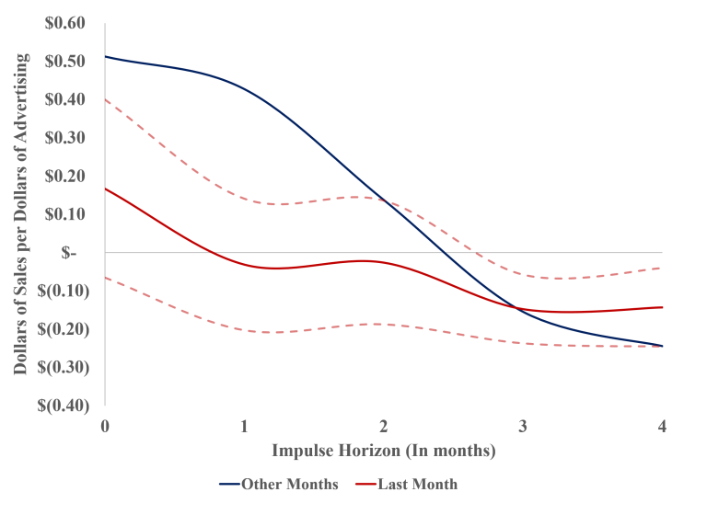
Performance
WSU
Heuristics
Consistent with the general prescription of marketing research, ad spend has positive effects on firms’ sales
For the average dollar of advertising, firms generate $1.08 of sales in the six months following expenditure
However, advertising efforts conducted in the last month of the fiscal year do not produce positive return on investment, generating $0.17 of sales over the 6 months following (84% reduction in advertising efficiency)

Slide 8
Project Selection
WSU
Our analysis identifies three channels that help us understand what can mediate subpar project selection during year-end:
Budget rationing
Matching the arrival of investment opportunities with the availability of funds to managers
Monitoring

Slide 9
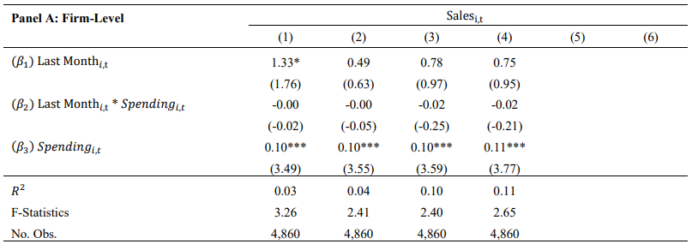
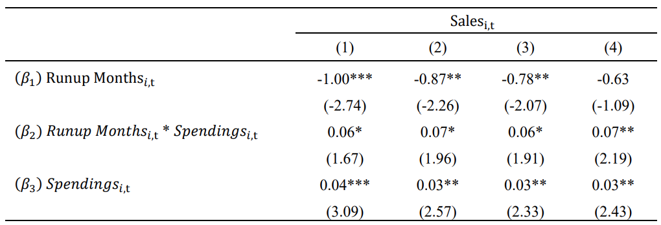
Budget Rationing
WSU
Project Selection
When capital rationing binds, authors find that year-end expenditures are as good as in any other month
Suggests that capital rationing helps mitigate the negative effect of overspending, but then monitoring helps mitigate inefficient resource allocation

Slide 10
Budget Rationing
WSU
Project Selection
When capital rationing binds, we find that year-end expenditures are as good as in any other month
Suggests that capital rationing helps mitigate the negative effect of overspending, but then monitoring helps mitigate inefficient resource allocation

Slide 11
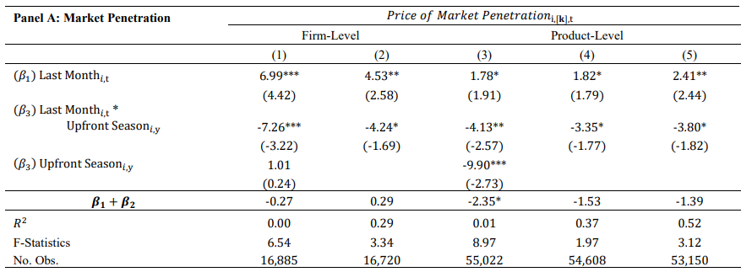
Performance and Timing
WSU
Project Selection
Looking at Managers with End-of-Year Months in May or June
Firms terminating their fiscal year during the upfront season select projects that are substantially better than their peers

Slide 12
Monitoring
WSU
Project Selection
Large and complex firms are harder to manage, often overextending managers… this forces them to divide their limited attention across multiple projects and subordinates at once

Slide 13
Conclusions
WSU
“Our evidence indicates that managerial incentives at lower levels of a firm’s hierarchy play an important role in a firm’s resource allocation.”
“Self-Dealing in Corporate Investment” – CEO Assets
In response to John Graham – what else?
Budget
“A course but direct measure of firms’ budgeting cap… we use the previous year’s annual expenditures as our budget proxy.”
Cut-off
Fiscal year end? How does seasonality affect the results?

